Slide 1
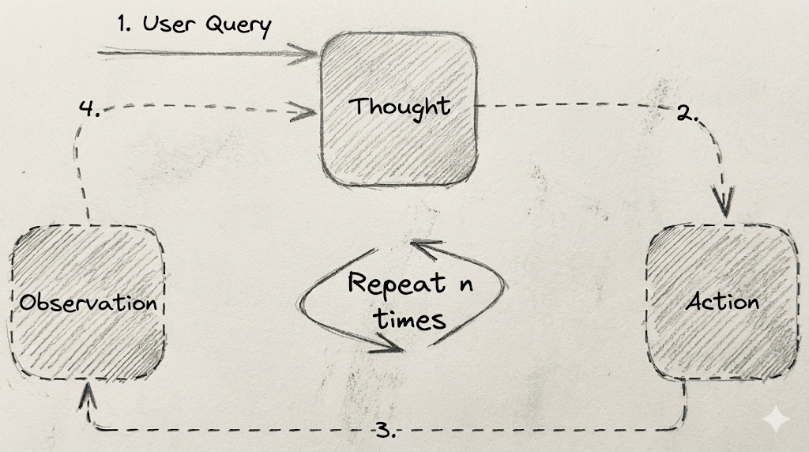
React

Slide 2
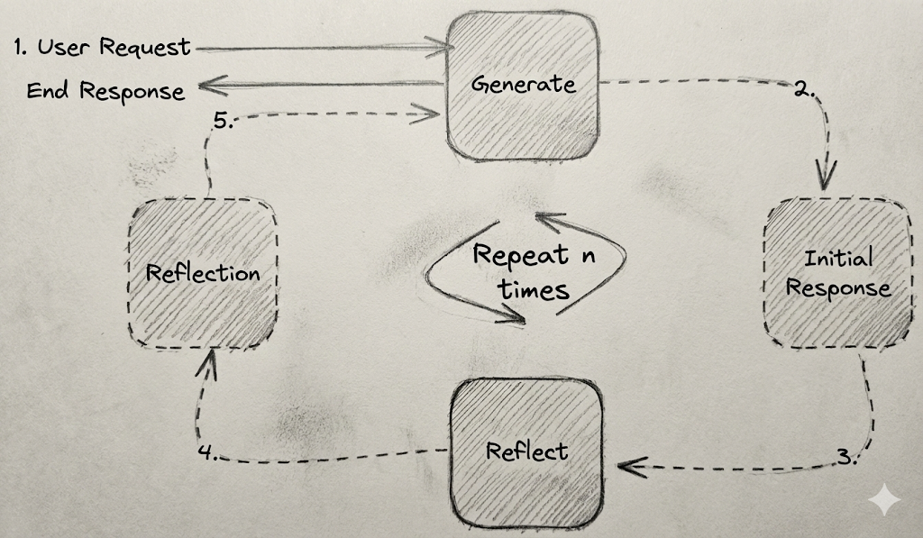
Reflection Agent

Slide 3
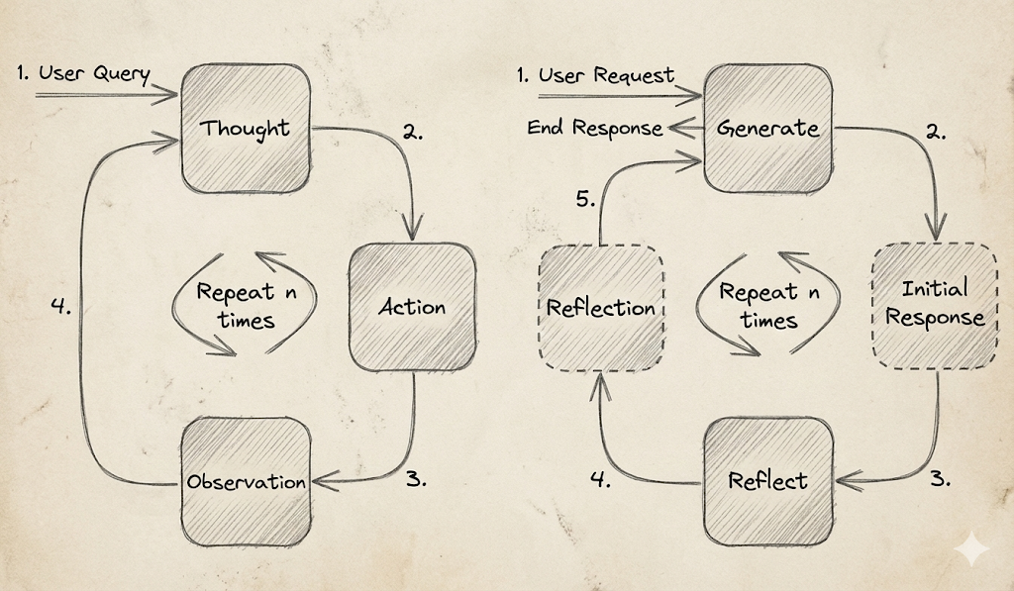

Slide 4
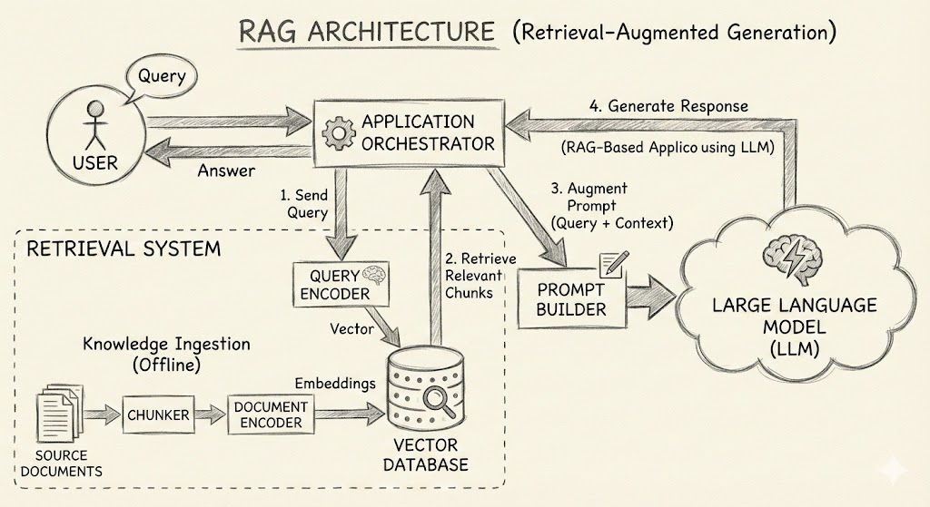

Slide 5
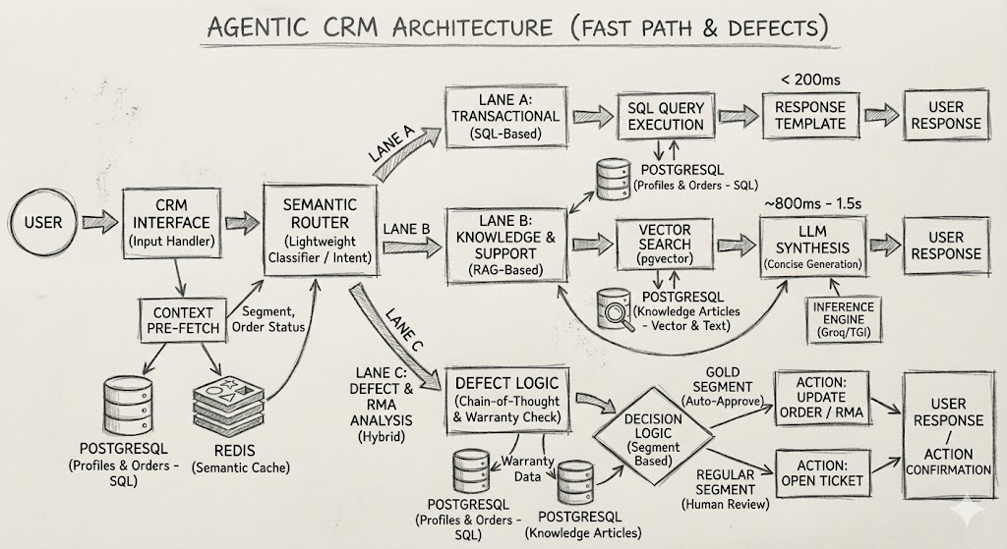

Slide 6
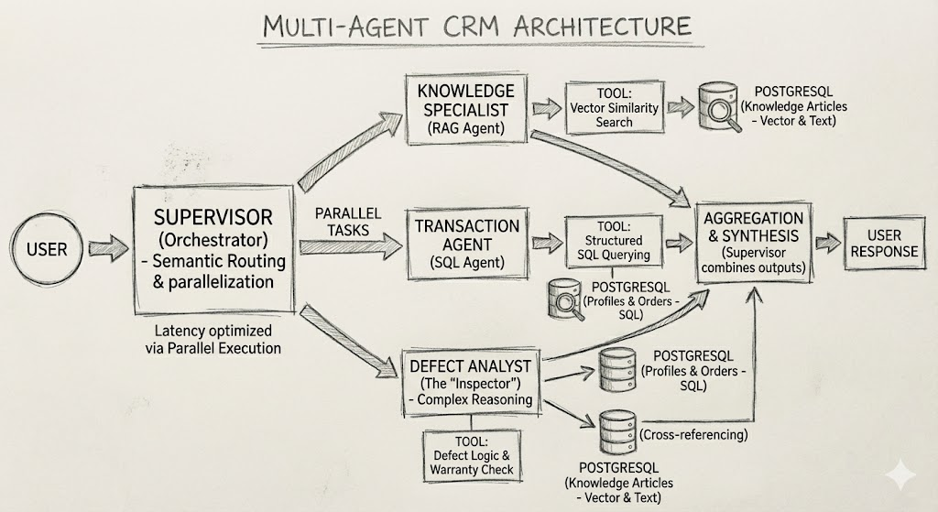

Slide 7
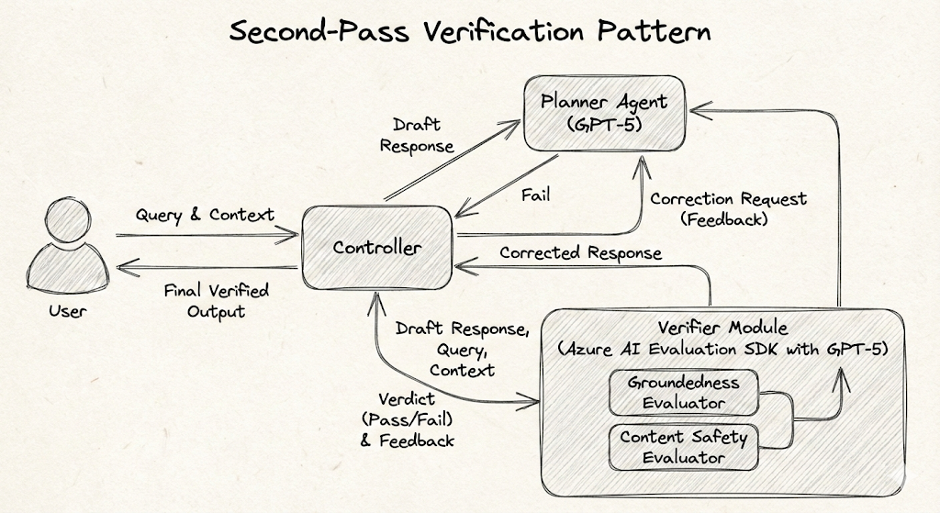

Slide 8
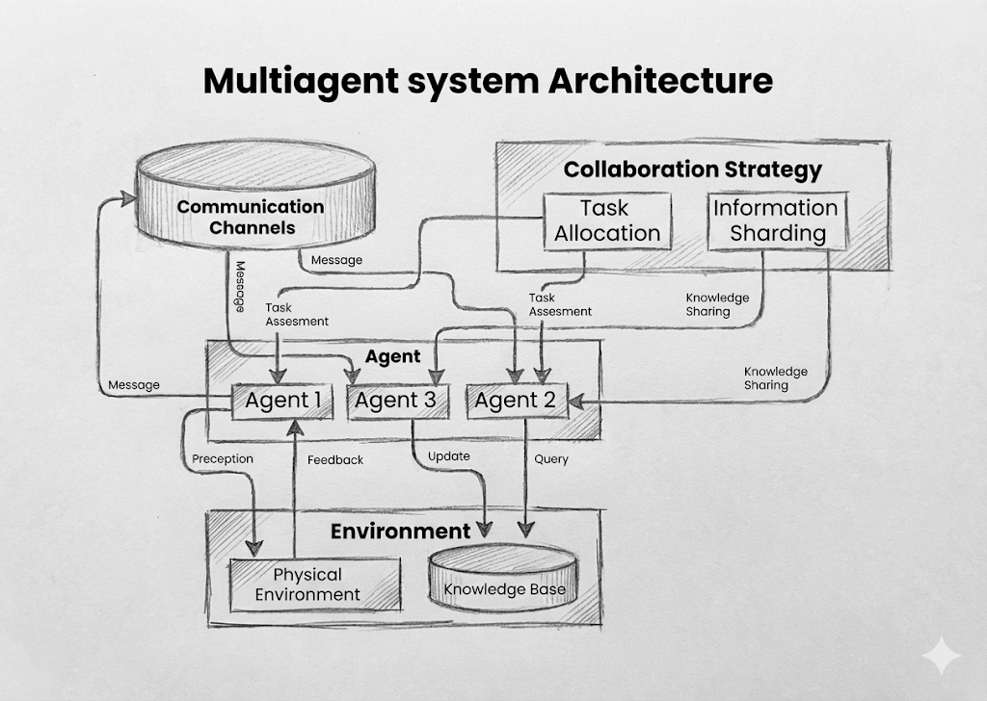

Slide 9
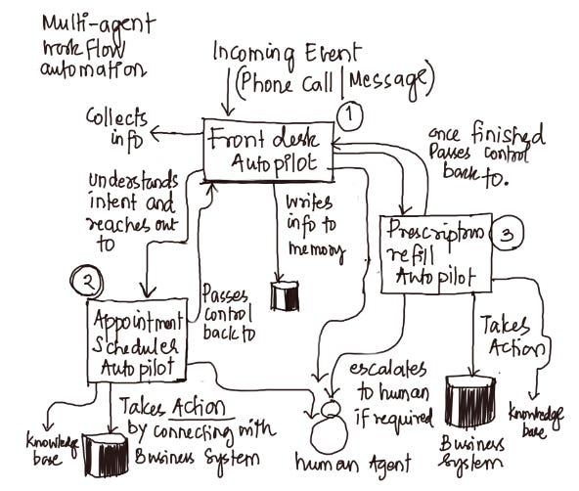

Slide 10
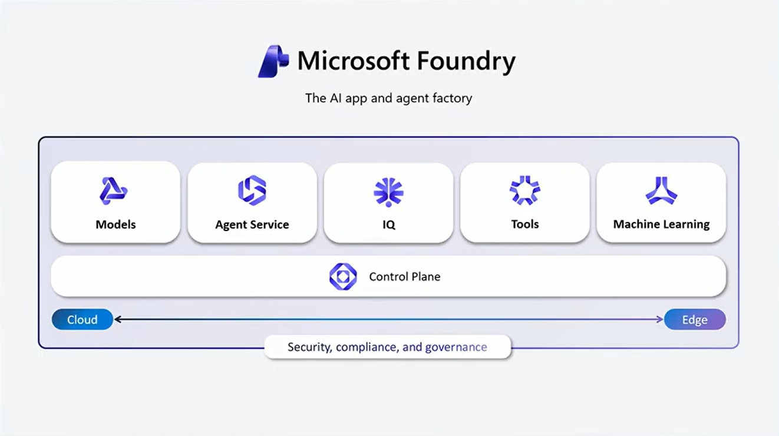
Agent Service – Agents with Tools and Knowledge Bases. Also Bring Your Own Agents as Hosted Agents
Foundry IQ – Bring Enterprise Knowledge with Agentic Retrieval Systems
Model Catalog - Deploy Models on Serverless Inferencing (Pay-Per-Token Pricing) from vendors like Meta, Claude, OpenAI, Grok etc.
Tools – Choose from a Variety of MCP Servers, Logic Apps, Vector Indices, OpenAPI Definitions etc.
Foundry Control Plane – Tracing and Observability for Agents
Fine Tuning – Make Base Models more domain centric with fine-tuning
Cloud Based Agents – Develop Cloud Native Agents to take full advantage of the Foundry Ecosystem
Entra ID – Govern Agent Identities with Microsoft Entra ID and enforce RBAC, Conditional Access Policies, PIM policies on Agent in M365
Microsoft Purview – Classify and Protect Data with Microsoft Purview and Foundry IQ
Foundry Local – Develop Fully Local Agents with Foundry Local

Slide 11
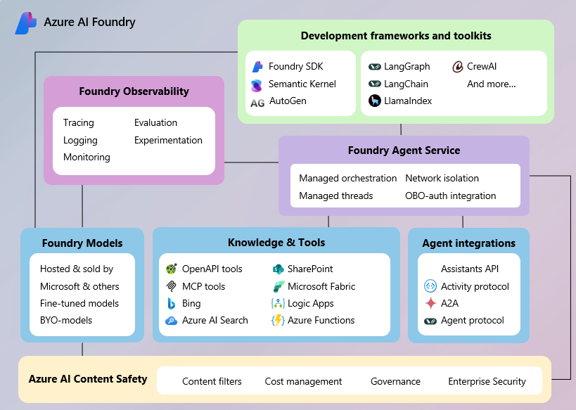
Tools and More….

Slide 12
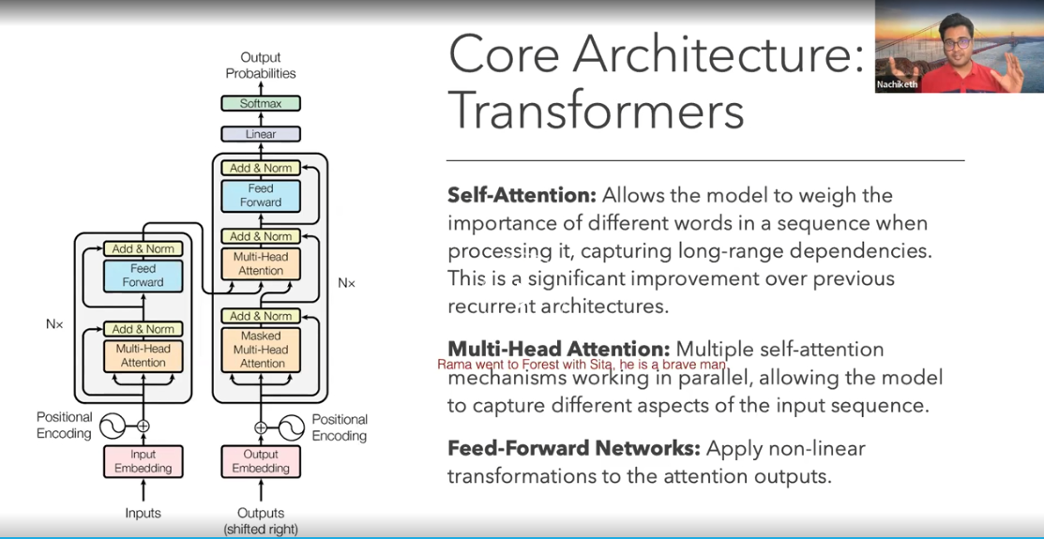
https://learn.manifoldailearning.com/web/courses/67bb63304d6bad9046be8a54?chapter=67bf60dbcb6a03d3f9ef4704

